Slide 1

SiMCO Data analytics Project
Gaurav Shinde
11/11/2022

Slide 2


Agenda
1. Background
2. Project goals​
3. Data Analytics Lifecycle​
4. Power BI Demo
5. Insight & Recommendation

Slide 3

Project Background
The Simco Company has seen consistent decline in their sales, overdue amount percentage has increased & there is need to improve the customer experience to their clients.
SimCo's last 4 years of order-to-cash data is analyzed and dashboard is built to track & monitor team performance, generate insights and recommendations at the end.

Slide 4
The Company overview
The SimCo Company Behind the Dataset
The Company, SimCo
Products
Business Units
Customers
Locations
SimCo is a globally distributed multinational for which we have data for 4 years of operation (Jan ’18 – Dec ’21).
The company is growing globally but there are variances to be found when examining performance through the lens of individual countries/ products etc.
The company offers 8 products. These do not have a set price so you can think of them as contracts for different service offerings where the contract price is unique to each transaction.
The products are available in all countries, although you should expect differences in the maturity of products in each region.
There are 3 business units. Each product is assigned to one of the two business units
Business units are presented as separate operations in the financial statements and are therefore very important for the C-suite.
The company has a large customer base with varied levels of customer loyalty.
The average spending patterns and days-to-pay varies by customer.
Additionally, customers have different payment terms depending on the amount they spend with SimCo.
The company operates across 33 countries with some countries in the early growth stage and others more mature
The dataset also contains information on the region in which the companies operate – split into Africa, Americas, Asia, Europe and Oceania
Each region has an assigned regional lead whose performance would be assessed on that region’s performance.

Slide 5
The datasets
Sales
Receivables
Receivables Month End
Calls
HIGH LEVEL VIEW OF SALES PERFORMANCE
DETAILED VIEW OF COLLECTIONS OPS
MONTH END SNAPSHOT OF RECEIVABLES
DETAILED VIEW OF CUSTOMER SERVICE
Dataset grain: individual sales transaction
Dimensions include customer_id, country, region, product_id, date and total sale
Dataset grain: individual sales transaction
Additional dimensions include payment terms, aging, payment date
Also contains information on the number of payment requests sent out (dunning count) and whether the customer pays automatically (is AutoPay)
Dataset grain: Outstanding receivable at month end for each unique combination of customer, product, country combination
Dataset grain: individual call to a customer who has an outstanding payment due
Additional dimensions include was Answered, call duration, call date, saleID (to link it back to a transaction)
Calls are made to customers who are 30 days overdue and are attempted daily until the customer answers the call

Slide 6

Project Goals
Problem Statement & Business Task

Slide 7


Problem Statement
Business Task
Analyze the sale affecting regions and determine high growth clients
Build interactive dashboard to track & monitor overdue% and customer experience metrics
Support stakeholder to make data-driven decision making to create sales campaign, understand agent performance and improve overall health of all 3 departments
Increase sales performance
Reduce the overdue % for aging 60-90 days
Optimize the customer experience rate

Slide 8
Data Analytics Lifecycle
Business Understanding
Operationalize
Data discovery
Communicate Results
Dashboard Development

Slide 9

Dashboard WALK
Power BI

Slide 10
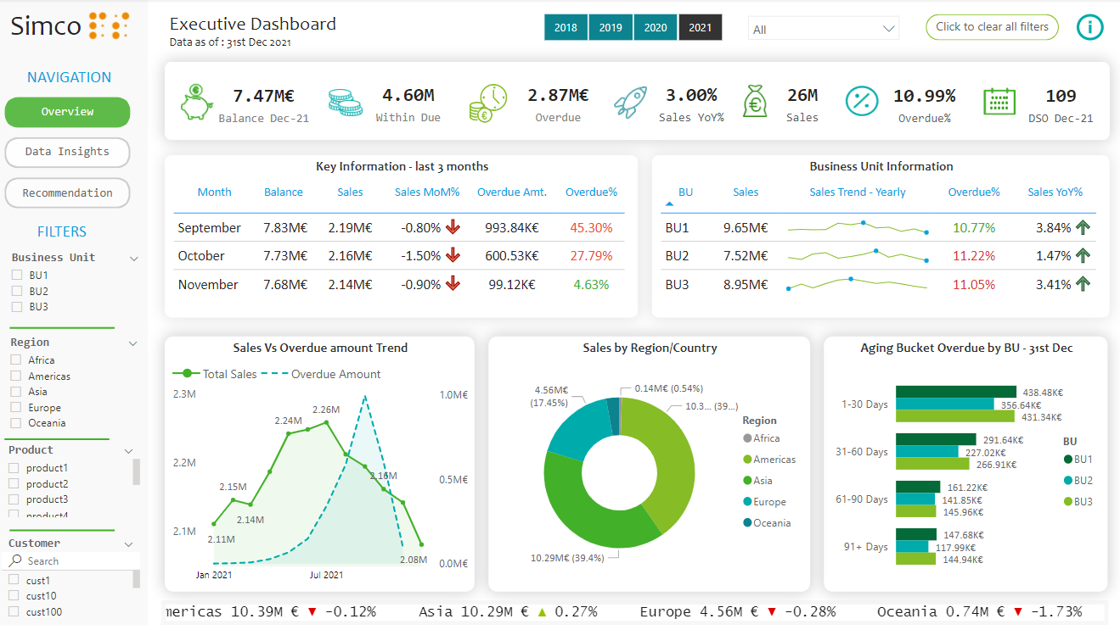
Key Benefits
Persona-Based Interactive Insights:- Dynamic dashboard views carefully architected to deliver customized insights for SimCo’s Executives & leadership team to enable insight to action.
Comprehensive Overview of Critical KPIs Dashboard enables improved visibility into key business drivers while also providing a comprehensive snapshot of the most critical performance KPIs across SimCo’s business.
Self-Service Analytics Flexible analytics engine enabling users to slice and dice Patients and Revenue data. Users can easily and quickly perform their own data discovery
Key features of the dashboard – Key Influencers, Python sales forecasting, and Smart narrative feature
Intuitive User-Experience, designed for Executive & leadership Audience

Slide 11

recommendations
Regional leads for Africa & Spain to revisit the sales strategies, initiate conversations with customers to understand any area of concerns.
Focus on high growth countries Romania and Turkey to increase the sales revenue
Agents to contact overdue customers 3 days prior the payment date

Slide 12


Thank YOU !!!

